Slide 1
Client Side Scripting
JavaScript Introduction

Slide 2
JavaScript
JavaScript is an interpreted language. What does this mean?
As the browser goes through the JavaScript, it passes it to a special program called an interpreter, which converts the JavaScript to the machine code your computer understands.
The JavaScript conversion happens at the time the code is run and it has to be repeated every time this happens.
Other interpreted languages include PHP and Ruby.
Compiled languages such as Java and C# have their code converted to machine code before it’s actually run, and this conversion has to be done once by a compiler.

Slide 3
JavaScript
JavaScript is untyped/ a loosely type language
This means that you don’t have to specify (declare) the type when you create a variable.
Case-Sensitive
Comments are the same as in Java, C, and Perl:
// used for single line comments
/* .... */ for multiple line comments

Slide 4
JavaScript
End-of-line semicolons are optional:
The semicolon in JavaScript is used to separate statements, but it can be omitted if the statement is followed by a line break (or there’s only one statement in a {block}).
var i; // variable declaration i = 5; // value assignment var i = 0; i++ // <-- semicolon obligatory // (but optional before newline) var i = 0 // <-- semicolon optional i++ // <-- semicolon optional
if( i === 5)
{ alert(“test”) } // <-- semicolon optional

Slide 5
JavaScript
JavaScript is primarily used to interact with users:
User input validation
Enhancement
JavaScript was originally created for validating form input. For example:
Checking if all required fields have been inserted
Checking whether specific input is within the correct range
Checking if the inserted data is of the correct type.
Thanks to the advances made in today’s JavaScript engines, JavaScript is used for much more .
Advanced JavaScript-driven applications can be created that rival the speed and functionality of desktop applications such as Google Maps and Google Calendar.
These applications provide a real service. In most of these applications, JavaScript only powers the user interface, with the actual data processing being done on the server. But even then, JavaScript could be used on the server if used with a JavaScript-based processing engine.

Slide 6
JavaScript: Inline
Inserting JavaScript into a web page is much like inserting any other HTML content; you use tags to mark the start and end of your script code.
The element you use to do this is <script>.
This tells the browser that the following chunk of text, bounded by the closing <script> tag is not HTML to be displayed, but rather script code to be processed. The chunk of code surrounded by the tags is called a script block. Example:
<script> //JavaScript goes here </script>

Slide 7
JavaScript: External JavaScript File
The <script> element also has the capability to specify that the JavaScript code is not inside the web page, but inside a separate file
You should give any external files the file extension .js
To link to an external JavaScript file, you need to create a <script> element similary to when inserting an inline script block
You would then need to use its src attribute to specify the location of the external file. Example:
<script src="myscripts.js"></script>
The browser reads this code and includes the file contents as part of your web page.

Slide 8
Advantages of Using an External File
It is important to get used to using an external file to include JavaScript rather than an inline script block.
Apart from having proper separation of concerns, there are various advatanges:
Code reuse: General complex functions are normally required in various web pages. If you include the code inline, you need to cut and paste the code into each web page that uses it. This is fine as long as you never need to change the code, but the reality is you probably will need to change or improve the code at some point. With an external file, you only need to change once, while with inline you need to modify every page.
Browser cache: Similary to how images are shared between pages, external JavaScript files are cached by the browser. If your files are large, this could save download time and also reduce bandwidth usage.

Slide 9
Document Object Model (DOM)
The Document Object Model (DOM) is an application programming interface (API) for HTML as well as XML.
It is primarily used for programmatic manipulation of web content.
Every element in HTML is equally representable via DOM through objects.
The DOM is the invisible structure of all the documents, a sort of container:
The overall container object is called the document
Any container within the document that has an ID is referenced by that ID
With JavaScript you have the power to manipulate the DOM objects which are:
HTML Document, HTML Element, HTML Attributes, HTML
Notes:
With the object model, JavaScript gets all the power it needs to create dynamic HTML

Slide 10
Document Object Model (DOM)
The HTML DOM is an object model and programming interface for HTML. It defines:
The HTML elements as objects
The properties of all HTML elements (HTML Elements values that can be set or changed)
The methods to access all HTML elements (actions that can be performed on HTML Elements)
The events for all HTML elements
In other words: The HTML DOM is a standard for how to get, change, add, or delete HTML elements.
Notes:
With the object model, JavaScript gets all the power it needs to create dynamic HTML

Slide 11
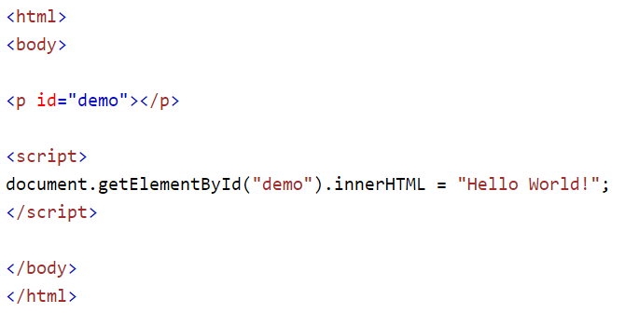
Document Object Model (DOM)
getElementById() is a method
innerHTML is a property

Slide 12
Document Object Model (DOM)
The DOM is a structured representation of the UI of a client-side web application that is, at least initially, built from the HTML code of a web application.
A page is generated by first having the browser receiving the HTML code
The browser parses the HTML code, one HTML element at a time, and builds a DOM - a structured representation of the HTML page in which every HTML element is represented as a node.
Although HTML and DOM are closely linked, with the DOM being constructed from HTML, they aren’t one and the same. You should think of the HTML code as a blueprint the browser follows when constructing the initial DOM (the UI of the page)

Slide 13
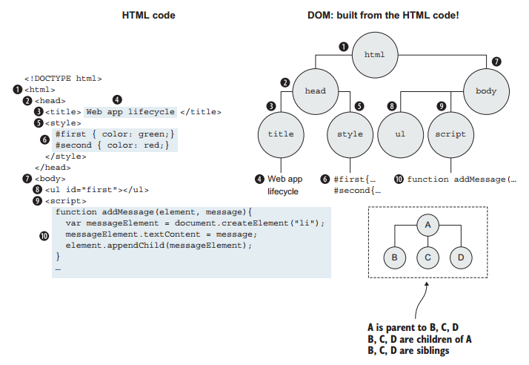
Document Object Model (DOM)
Notice how the nodes are organized such that each node except the first one (the root html node) has exactly one parent. For example, the head node has the html node as its parent.
At the same time, a node can have any number of children. For example, the html node has two children: the head node and the body node.
Children of the same element are called siblings. (The head node and the body node are siblings.)

Slide 14
Document Object
When an HTML document is loaded into a web browser, it becomes a document object.
The document object is the root node of the HTML document and the "owner" of all other nodes:
element nodes
text nodes
attribute nodes
comment nodes
The document object provides properties and methods to access all node objects, from within JavaScript.

Slide 15
Some Document Object Properties
document.activeElement
Returns the currently focused element in the document
document.anchors
Returns a collection of all <a> elements in the document that have a name attribute
document.body
Sets or returns the document's body (the <body> element)
document.domain
Returns the domain name of the server that loaded the document
document.forms
Returns a collection of all <form> elements in the document

Slide 16
Some Document Object Methods
document.createElement() Creates an Element node
document.getElementById() Returns the element that has the ID attribute with the specified value
document.getElementsByClassName() Returns a NodeList containing all elements with the specified class name
document.getElementsByName() Returns a NodeList containing all elements with a specified name
document.getElementsByTagName() Returns a NodeList containing all elements with the specified tag name

Slide 17

JavaScript Practice
Access Moodle and work out Worksheet 3

Slide 18
References
Johnson, G. (2013). Programming in HTML5 with Javascript and CSS3. United States of America: Microsoft Press.
John Resig, B. B. (2016). Secrets of the JavaScript Ninja, Second Edition. Shelter Island, United States of America: Manning.
McPeak, J. (2015). Beginning JavaScript, 5th Edition (5 ed.). Wrox.

